Slide 1
자치 차량
자율 주행 자동차

Slide 2
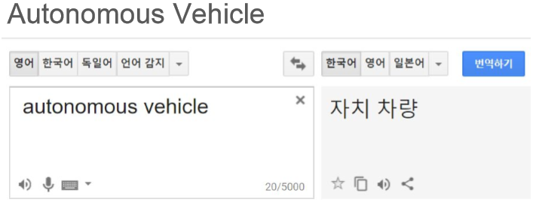
자치 차량이란?
- https://github.com/hamuchiwa/AutoRCCar/tree/master/computer
- https://github.com/DevParapalli/self-driving-car-using-RPi-Arduino
- https://www.youtube.com/watch?v=BBwEF6WBUQs&feature=youtu.be

Slide 3
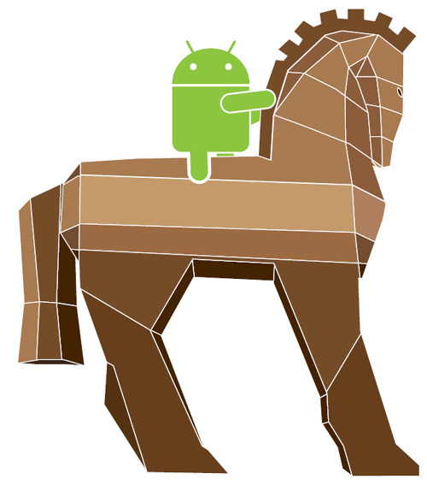

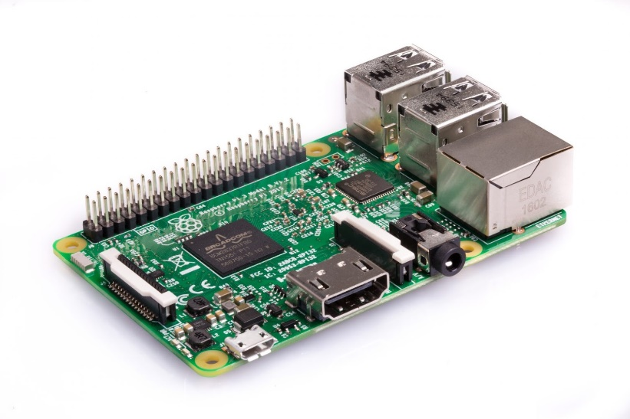


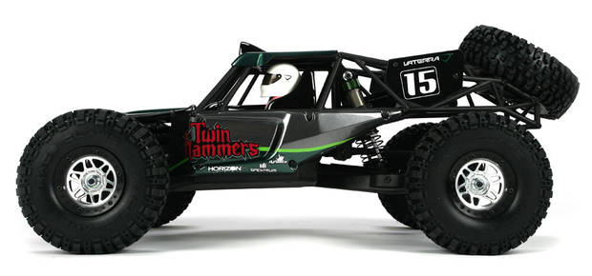
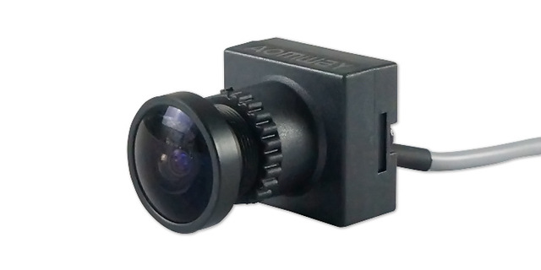


구현 방법

